Slide 1

Mid-Sem Presentation:
Scheduling in
Dynamic-Core Architectures
Presented by: Hatim Shakir (B200830CS), Arif Raza Mansuri (B200808CS), Anagha MV (B200726CS)
Guided & Supervised by: Nirmal Kumar Boran Department of Computer Science & Engineering, NIT Calicut

Slide 2
TABLE OF CONTENTS.
01
02
03
04
05
06
Introduction
Motivation
Literature Survey
Research Gap
Our Proposal

Slide 3
TABLE OF CONTENTS.
01
02
03
04
05
06
Harnessing ISA Diversity: Design of a Heterogeneous-ISA Chip Multiprocessor
Execution Migration in a Heterogeneous-ISA Chip Multiprocessor
Paper - 3
Paper - 4
Paper - 5
Our project, motivation and methodologies

Slide 4
Harnessing ISA Diversity
01
Venkat, A. and Tullsen, D.M., 2014. Harnessing ISA diversity: Design of a heterogeneous-ISA chip multiprocessor. ACM SIGARCH Computer Architecture News, 42(3), pp.121-132.

Slide 5
Motivation
Performance! Performance!

Slide 6
Motivation (cont.)
1. Choosing multiple-ISAs to exist in a core is a promising avenue for performance gains
a. ISA diversity brings characteristic differences in code density, decode and instruction complexity, register pressure, native-floating point arithmetic vs Emulation, and SIMD processing
b. Design of such a Heterogeneous ISA Chip Multiprocessor is a complex task due to large search space and billions of combinations.

Slide 7
Motivation (cont.)
2. ISA Heterogeneity is beneficial:
a. Across multiple different application programs
b. Across multiple phases of the same programs
3. Migration across ISAs is a well-known hard problem.

Slide 8
Methodology
ISA Diversity:
Discussion of some axes of heterogeneity among ISAs:
1. Code Density
2. Dynamic Instruction
3. Register Pressure
4. Floating Point and SIMD Support
ISA Diversity:
Target ISAs are selected a priori – and adding more ISAs will only push the performance improvement even further..

Slide 9
Methodology (cont.)
Design Space Exploration (II)
According to the paper’s assumptions, the cartesian product itself is 750 thousand for one core — multiple core is exponential!
Design Space Exploration (I)
ISAs are characterized by numerous parameters — ISA, execution semantics, Issue width, Branch Predictors, Reorder Buffer and many more…

Slide 10
Methodology (cont.)
Design Space Exploration (III)
The solution to problem is pruning — the design is reduced based-off observations such as correlation between register file size and reorder buffer size, number of functional units and issue width etc..
Design Space Exploration (IV)
The pruned design space has a much smaller design space — 120-inorder cores and 480 out-of-order cores — however, the number of combinations for 4 cores is still 129.6 BILLION!

Slide 11
Methodology (cont.)
Design Space Exploration (V)
The solution — decoupling last-level caches to separate individual core performances. Thus, the combined performance is the arithmetic sum of performances and software simulations decrease significantly
Design Space Exploration (VI)
While the design space exploration still involves finding the optimal 4-core configuration out of 129.6 billion different configurations, we can now find the best design with 600 simulations.

Slide 12
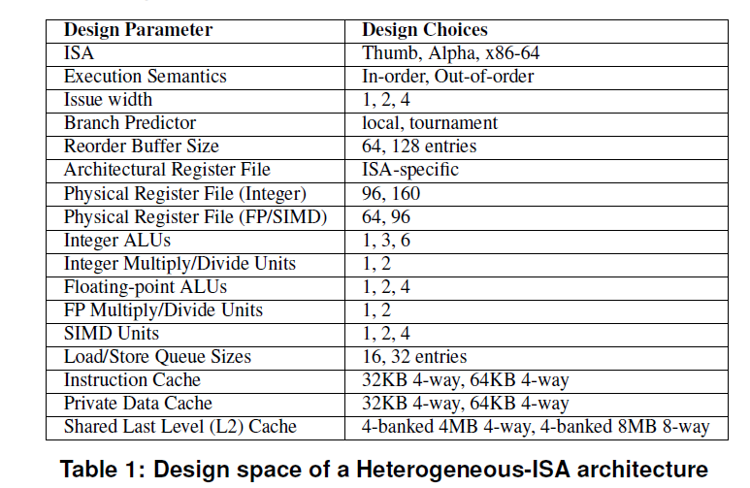
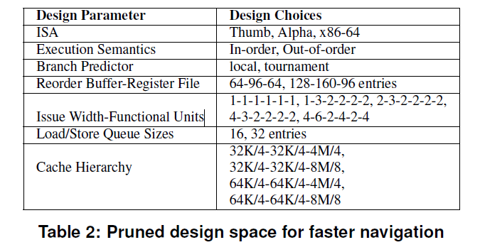
Methodology (cont.)

Slide 13
Methodology (cont.)
Compiler and Runtime Environments (II)
4. Generation of runtime transforms
5. Runtime Environment:
a. Dynamic Binary Translator
b. Program State Transformer
Compiler and Runtime Environments (I)
1. Unified Address Space
2. Common Intermediate Representation
3. Stack Frame Organization (taken from DeVuyst et. al)

Slide 14
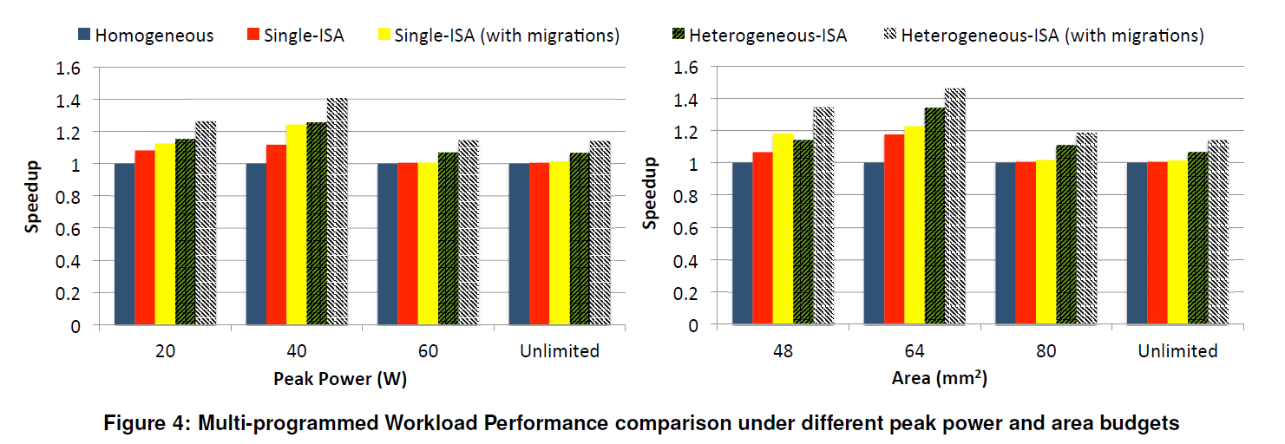
Results

Slide 15
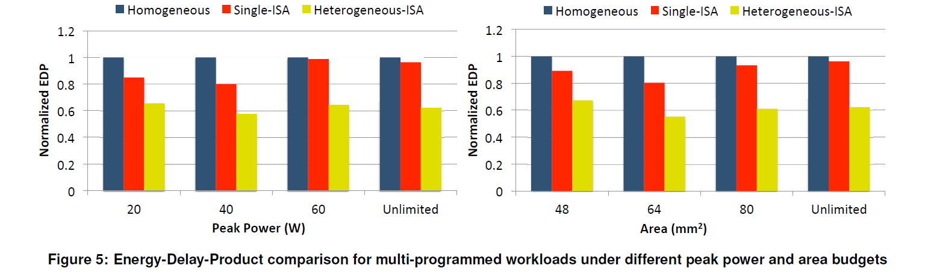
Results (cont.)

Slide 16
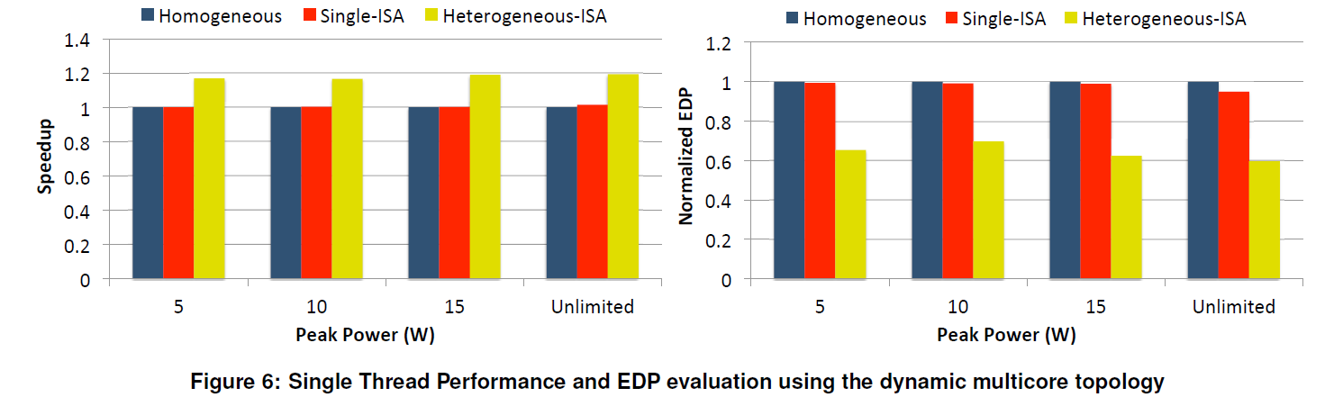
Results (cont.)

Slide 17
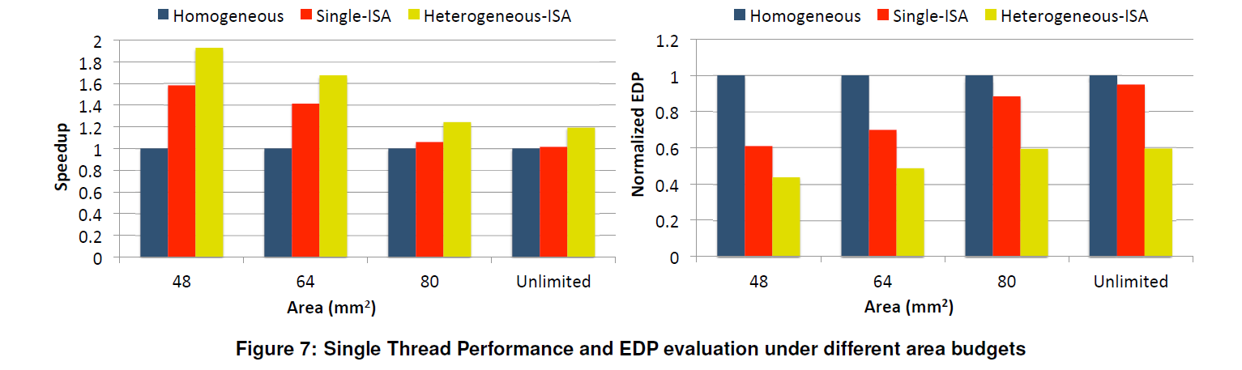
Results (cont.)

Slide 18
Results (cont.)
1. Additional speedup of 11.2% due to migration alone on a heterogeneous-ISA CMP, in contrast to the 4.6% speedup due to migration on a single-ISA heterogeneous CMP
2. Heterogeneous-ISA CMPs achieve an average energy savings of 21.5% and an average reduction of 27.8% in the EDP over single-ISA heterogeneous CMPs, with absolutely no loss in performance

Slide 19
Results (cont.)
3. We find that heterogeneous-ISA CMPs can provide 15.8% better throughput on multi-programmed workloads than the best single-ISA heterogeneous CMPs.
4. In a highly peak power constrained environment,the heterogeneous-ISA CMP still manages to achieve a speedup of 16.9% over a single-ISA heterogeneous CMP.

Slide 20
Execution Migration
02
DeVuyst, M., Venkat, A. and Tullsen, D.M., 2012, March. Execution migration in a heterogeneous-ISA chip multiprocessor. In Proceedings of the seventeenth international conference on Architectural Support for Programming Languages and Operating Systems (pp. 261-272).

Slide 21
Motivation
Faster Migration! Less Transformation!

Slide 22
Motivation (cont.)
Research shows the evidence for higher performance and energy efficiency in Heterogeneous ISA CMP.
2. This requires efficient migration across ISAs.
3. It is achieved by as little transformation of program state as possible.
4. Thus, is achieved by making program state consistent at several points throughout execution.
Notes:
Add citation for point 1 (prior research).

Slide 23
Methodology
2. Memory Image Consistency:
a. Global data consistency
b. Code section consistency
c. Heap Consistency
1. Assumptions:
a. Same endianness for all ISAs
b. Same fundamental datasize

Slide 24
Methodology (cont.)
2. Memory Image Consistency (cont.)
d. Stack Consistency:
i. Function Arguments
ii. Caller vs Callee register spills
iii. Local Variables
3. Stack Transformer
a. The paper proposes a two-pass mechanism for stack transformation

Slide 25
Motivation (cont.)
Research shows the evidence for higher performance and energy efficiency in Heterogeneous ISA CMP.
2. This requires efficient migration across ISAs.
3. It is achieved by as little transformation of program state as possible.
4. Thus, is achieved by making program state consistent at several points throughout execution.
Notes:
Add citation for point 1 (prior research).

Slide 26
Methodology (cont.)
3. Stack Transformer (cont.)
The first pass begins from innermost stack to outermost stack frame.
It collects information about: live registers across a function call site and collects their values ii. caller saved registers and collects their values iii. updates return addresses.
3. Stack Transformer (cont.)
c. The second pass uses the information collected in first pass to update the register state at each call site
d. and this information is used to build the stack frames in migrated core.

Slide 27
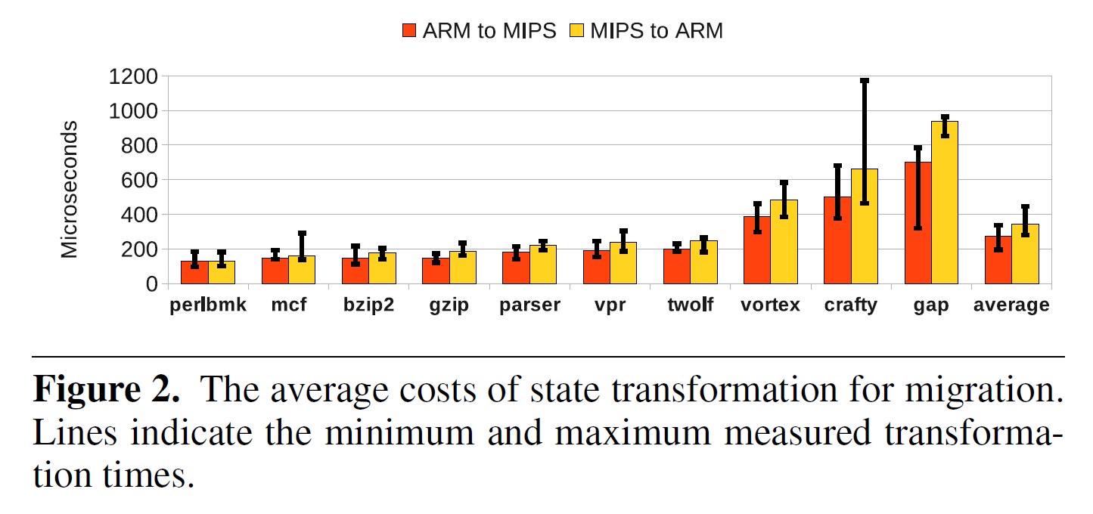
Results

Slide 28
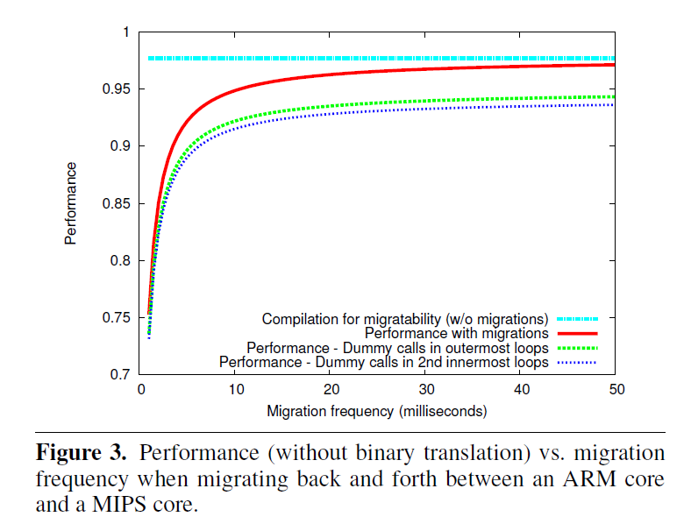
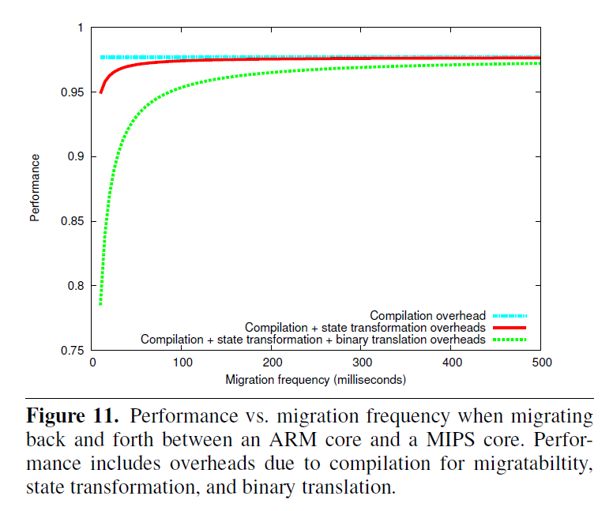
Results (cont.)

Slide 29
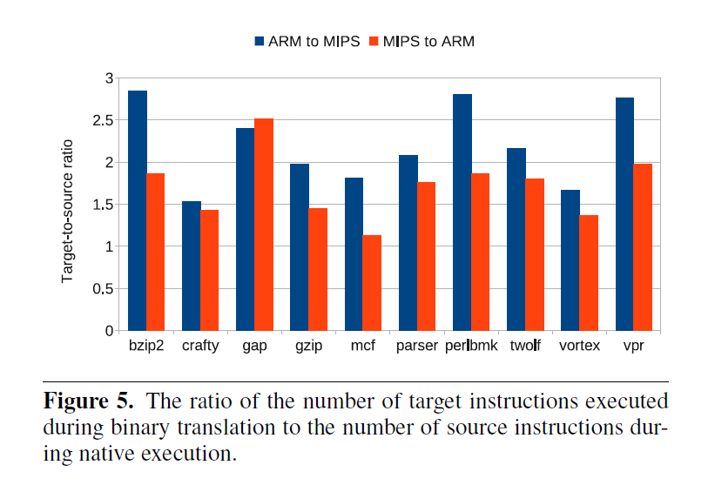
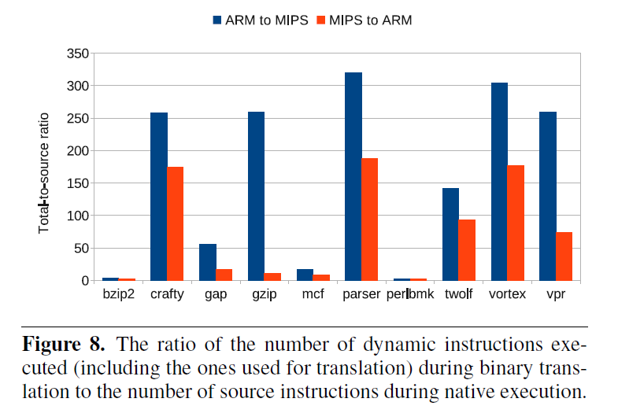
Results (cont.)

Slide 30
Results (cont.)
Even if we were to migrate every few hundred milliseconds, we experience a total loss in performance of well under 5%.
Notes:
Selection of appropriate WHEN to migrate and GRANULARITY should be computed carefully.

Slide 31
Performance Modelling
03
<p> Nirmal Kumar Boran, Dinesh Kumar Yadav, and Rishabh Iyer. Performance modelling and dynamic scheduling on heterogeneous-isa multicore architectures. </p>

Slide 32
Background
Venkat et al. made significant contributions to single-threaded program performance, power efficiency, and the energy-delay product through the introduction of ISA heterogeneity.
Their research divided programs into multiple phases, each comprising 100 million dynamic instructions.
Their work revealed that each phase exhibited a strong affinity towards a specific ISA.
Factors influencing this affinity included code density, dynamic instruction count, and register pressure.

Slide 33
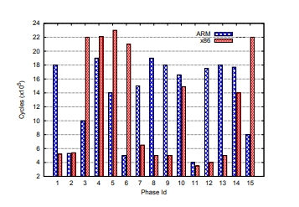
Background..
Execution time of different phases of benchmark astar

Slide 34
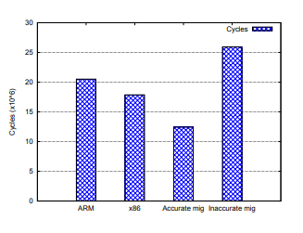
Background..
5. By executing each phase on its most affined ISA, substantial speedups were achieved, surpassing the performance when running all phases on a single ISA.

Slide 35
Motivation
To bridge the gap between the prospective gains of Heterogeneous ISA Multicore Architecture (HeIMC) and on how to achieve them.
Venkat et al. do not address this issue at all, assuming the existence of a prediction oracle which makes perfect decisions.
The upper bound for the performance increase is 39% (without migration overhead) but is it’s done in-accurately it can deteriorate the performance by 26%.

Slide 36
Prior Work
First work was by Kumar in his 2003 paper Single-ISA heterogeneous multi-core architectures who used a sampling base technique.It’s limitations :
Poor resource utilization.
Does not scale with increasing core count.
Later some regression based model using ILP and MLP were used for estimating migration while this worked well for HeMC.Its limitation
Not designed to take into account factors that determine performance variation across ISAs
For example code density, register pressure and instruction mix etc.

Slide 37
Methodology
Goal : To devise a model that takes in account the micro-architectural and ISA specific parameters.
13 parameters were used for the execution time prediction. After that the time is fed into a scheduler then greedly selects the best ISA for the next phase.
The parameters include branch miss-predictions, L1-I-cache misses, L1-D-cache misses,L2 cache misses, Reorder Buffer full events, Instruction Queue full events, Store Queue full events, ILP, MLP, MSHR full events,instruction mix and the dynamic instruction count.
Notes:
Divide into smaller bullets.

Slide 38
Scheduler :
Challenge:
This division of the program into phases poses a significant challenge for the scheduler.
The first few (10-20M) instructions of the phase to predict which ISA it is suited to.
Since migration can only occur at the equivalence points.
Scheduling decisions must be made before the phase begins to execute.

Slide 39
Scheduler :
Solution:
They took the 10 million instruction from the current running phase and feed to regression-based performance model this works because it is small yet a significant number of instruction and is close to next phase.
Once they got the time for all the ISAs a greedy scheduler was employed.

Slide 40
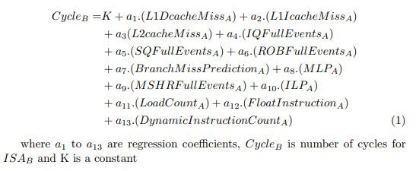
Linear regression model :

Slide 41
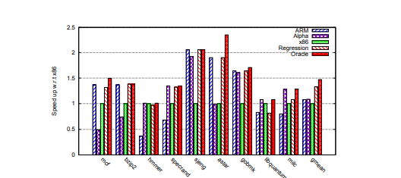
Results:
Average speedup of different benchmarks when entire program is scheduled on ARM, Alpha or x86 and compared with HeIMC architecture with regression and oracle based scheduling

Slide 42
Fine-Grain Scheduling
04
<p> Nirmal Kumar Boran, Shubhankit Rathore, Meet Udeshi, and Virendra Singh. Fine-grained scheduling in heterogeneous-isa architectures. IEEE Computer Architecture Letters, 20(1):9– 12, 2020 </p>

Slide 43
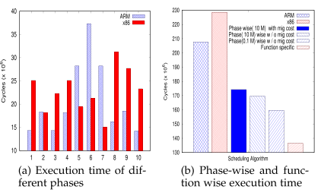
Motivation..

Slide 44
Motivation
To effectively exploit program heterogeneity, Boran et al. introduced a fine-grained function-wise scheduling technique. This approach dynamically scheduled every function to its most affined ISA
Reason for Function Affinity :
code density,dynamic instruction count, register pressure, etc. which varies for each function.
This affinity of a function towards an ISA may only shift by the change in behavior of input data. Hence the need for a dynamic predictor.
Notes:
Include graph from paper..

Slide 45
Motivation
3. Function-wise scheduling not only optimized performance but also minimized migration overhead by transforming only function arguments between ISAs, avoiding complete stack transformations.

Slide 46
Methodology
The migration decision for a function is taken just before a function is called.
The function is executed on it’s best affine
ISA and the stack frame for the function is also formed in it’s best affine ISA format.
Need to transform only local parameters passed by the caller function to callee function.
Rest of the memory i.e., global and heap, is common across both ISAs

Slide 47
Heuristic Based Approach
It was observed that the affinity do not change too often.
They used a sampling based technique for dynamic prediction.
It was experimentally observed that affinity do not change for approximately 20 consecutive calls.
Execution time is calculated for 19th and 20th call and the Affinity table is updated.

Slide 48
Results
They used GEM5 simulator for running spec 2006 benchmark for X86 and ARM ISA.
Migration : Migration overhead is less, since only a few register values have to be transformed.
Performance :
The proposed approach achieves up to 22.9 percent speedup using oracle based scheduling mechanism
The proposed heuristics technique achieves a speedup of 8.4 percent.

Slide 49
Results..
They used GEM5 simulator for running spec 2006 benchmark for X86 and ARM ISA.
3. Multi-work load : An average speedup of 15.6 percent is achieved.

Slide 50
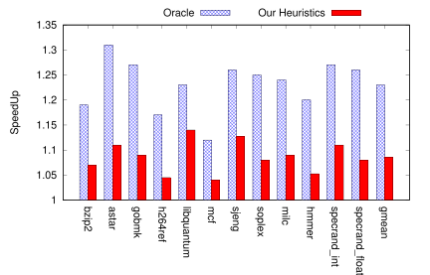
Results..
Speedup of function-wise migration with respect to heterogeneous-ISA architecture

Slide 51
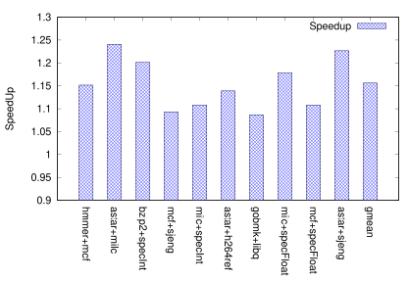
Results..
Speedup of function-wise migration with respect to heterogeneous-ISA architecture for multi-workloads.

Slide 52
Composite Cores
05
Composite cores:Pushing Heterogeneity into a Core
Andrew Lukefahr,Shruti Padmanabha ,Reetuparna Das ,Faissal M Sleiman ,Ronald Dreslinski ,Thomas F. Wenisch and Scott Mahlke IEEE/ACM International Symposium on Microarchitecture, pages 317–328, 2012.

Slide 53
Motivation
HERE, WE ARE INTRODUCING the concept of composite cores, that can promise you the energy savings.
To get an idea about the composite cores we have taken the reference of the research paper named “Composite cores – pushing heterogeneity into a core issued by Andrew lukefahr and his team” .
The team was able to concluded with a result of 18% of energy savings and 5% of performances loss.
Notes:
Make it 3rd paper..

Slide 54
Approach
Research paper -
1.They have done the concept of increasing energy savings and reducing energy consumption is by identifying phase changes in an application and migrating execution to the most efficient cores that meets its current performances requirements .
2.They evaluate composite cores using cycle accurate microarchitectural stimulations and a detailed power model.
3. Results show that on average , the controller is able to map 25 % of the execution to the little engine , achieving an 18% energy savings while performances loss to 5%

Slide 55
Key Insights
In there paper they have proposed a composite core, an innovative architecture that reduces the switching overheads by bringing the notion of heterogeneity within a single cores ie.
1. it gives switching overheads in heterogeneous multicore systems.
2. The small and big compute Engine within single core gives high performances and energy efficiency.
3.By sharing the significant portion of the architecture state between engine ,they can reduce the switching overhead to nearly zero,which will facilitate fine graining switching( max the utilization in little engine)

Slide 56
Our project and its Motivation
06
The main aim to is bridge the performance gap proposed by Boran et al. and add energy efficiencies

Slide 57
Motivation
Bridging the gap between 8% and 23%

Slide 58
Motivation (cont.)
The introduction of functional level scheduling by Boran et al. has proved very advantageous due to negligible cross-ISA migration overhead. We aim to exploit this property for our research...

Slide 59
Motivation (cont.)
The heuristic technique, as introduced by Boran et al. exhibits an 8.4% speedup only, showing its potential. However, we see an opportunity for further improvement...

Slide 60
Motivation (cont.)
Another limitation in the technique is that it needs one or two forced migrations every 20 function calls, which is unnecessary overhead. We aim to propose a predictor for the behaviour of the function and take the decision in advance.

Slide 61
Methodology
The paper by Boran et al. has paved the way for promising performance gains, however, the inefficient core scheduling approach leaves out potential gains.
We aim to bridge this gap by more efficient scheduling algorithms based on microarchitectural parameters and run-time statistics, and employing mathematical and machine learning models to predict the most efficient core...

Slide 62
Methodology (cont.)
In addition to performance gains, we aim to achieve energy efficiency in the cores through a dynamic scheduling for In-order vs Out-of-order cores, tolerating a threshold performance loss, if any...
Notes:
Make it target (II). this is a second target :

Slide 63
THANK YOU!
Hatim Shakir,
B200830CS
Arif Raza Mansuri, B200808CS
Anagha M V,
B200762CS
Do you have any questions?

